Slide 1

A Sustainable and
Progressive Future:
CyanoStat
Stephanie Conley
CSE 237D, Spring 2014
UC San Diego

Slide 2
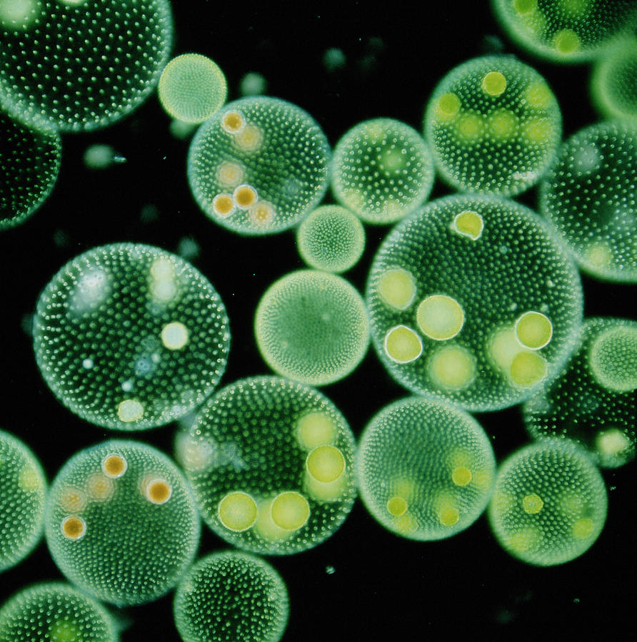
VOLVOX

Slide 3
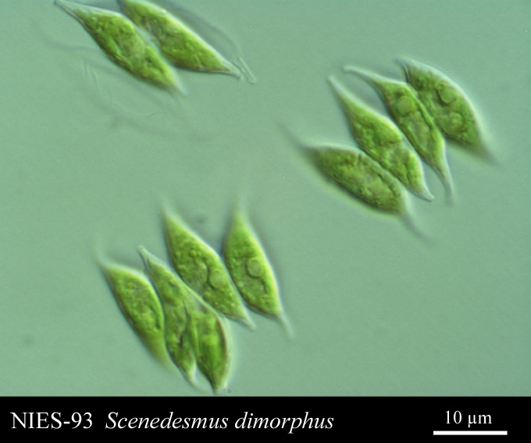

Slide 4
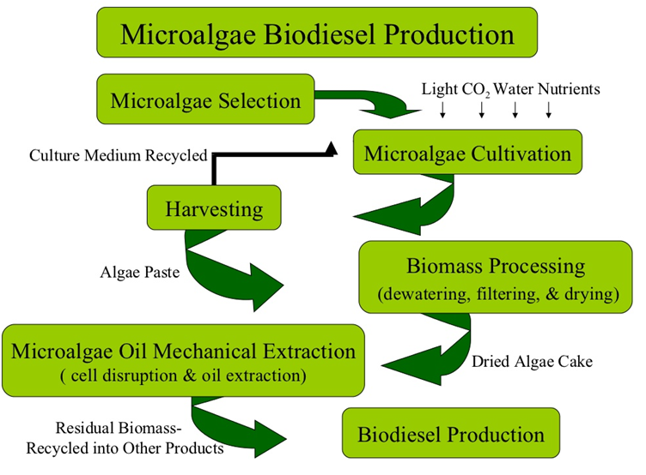

Slide 5

What is the CyanoStat?

Slide 6
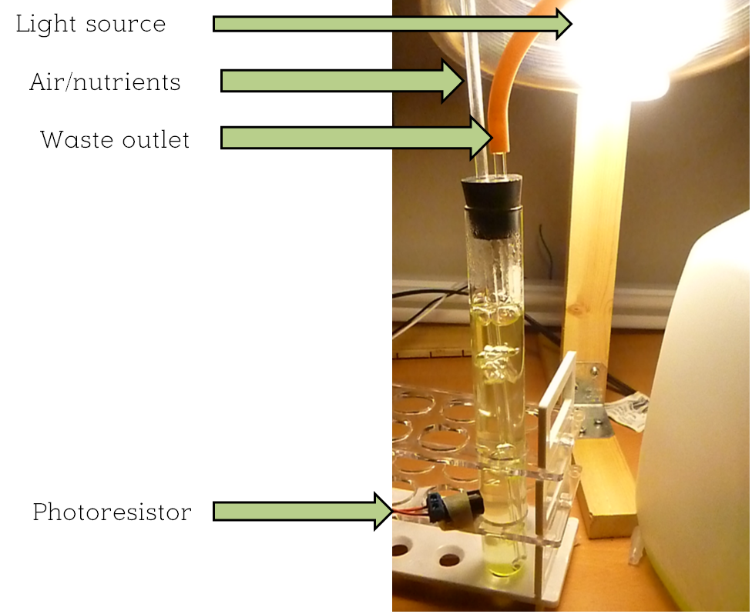
Grows Algae

Slide 7
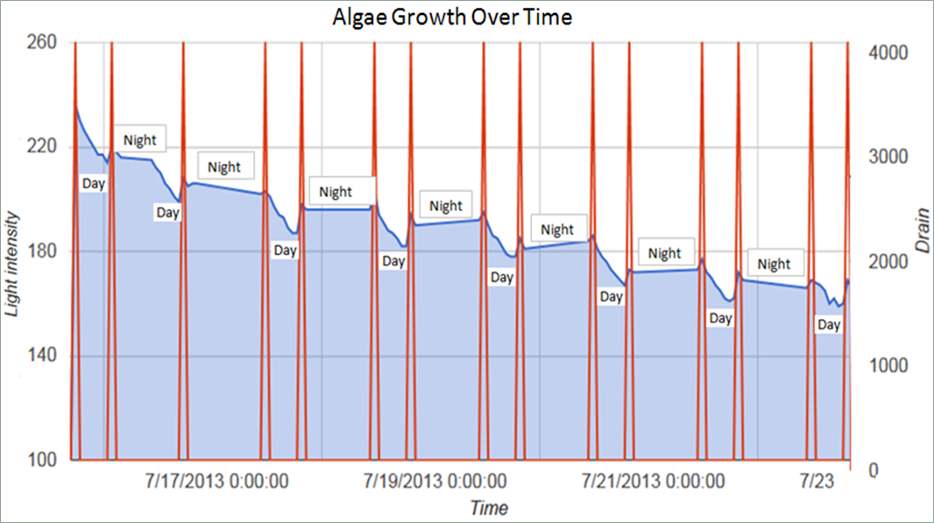
Charts Algae Growth
Real time data acquisition!

Slide 8
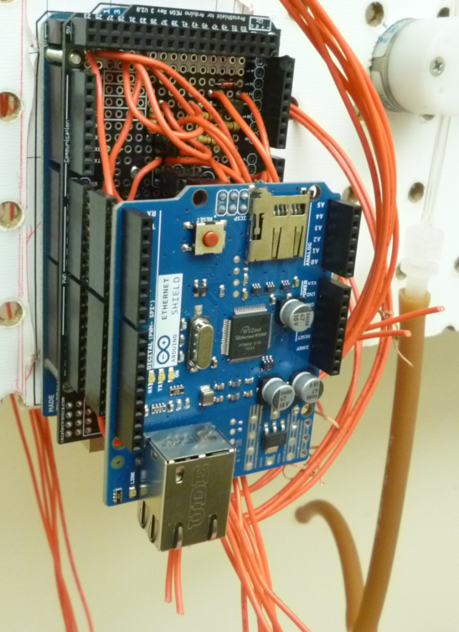

Utilizes Embedded System
Reduced Production Costs!

Slide 9
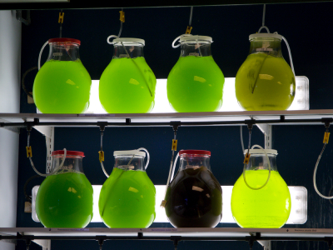
Handle Different Strains

Slide 10
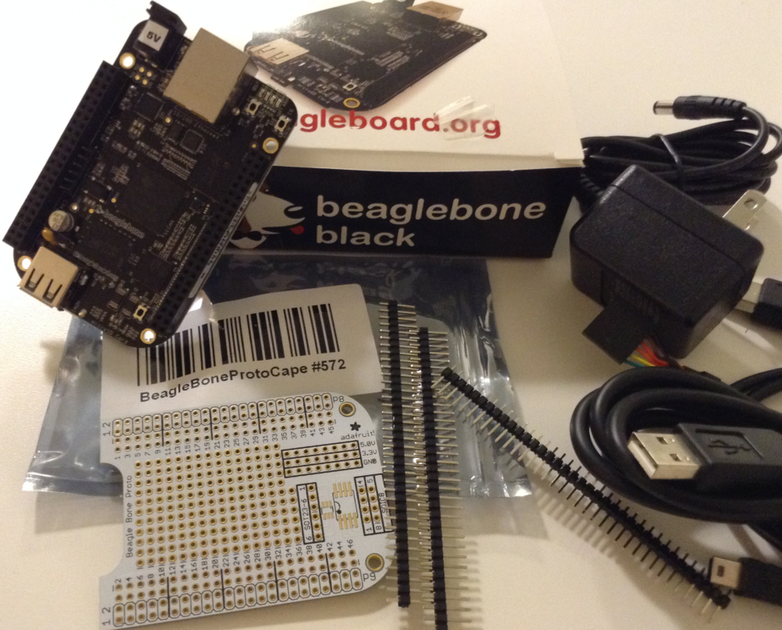
Progress: BeagleBone Black

Slide 11
Progress: Code
Previous: C for Arduino

Slide 12
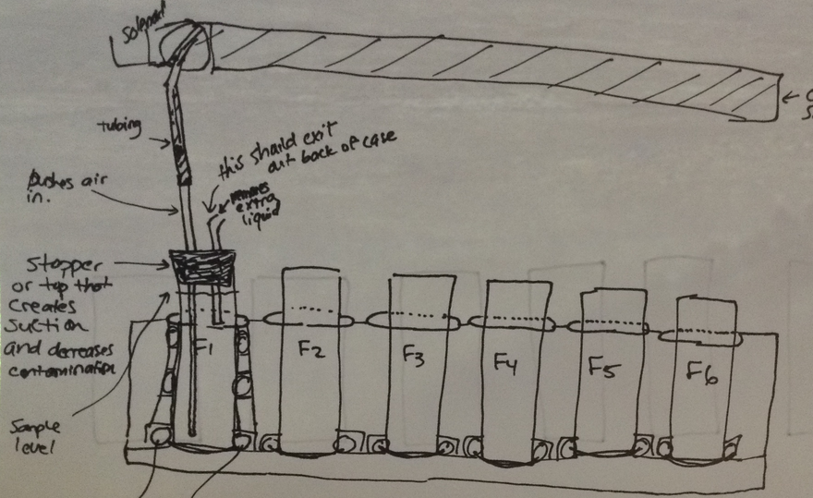
Progress: Organization

Slide 13
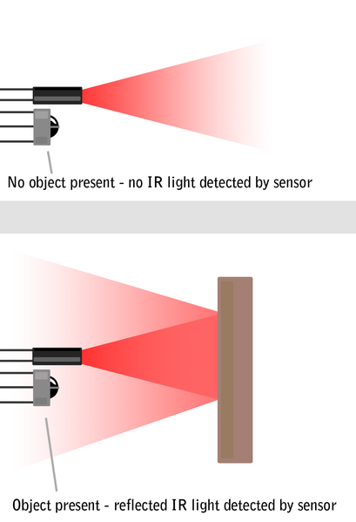
IR Sensors

Slide 14
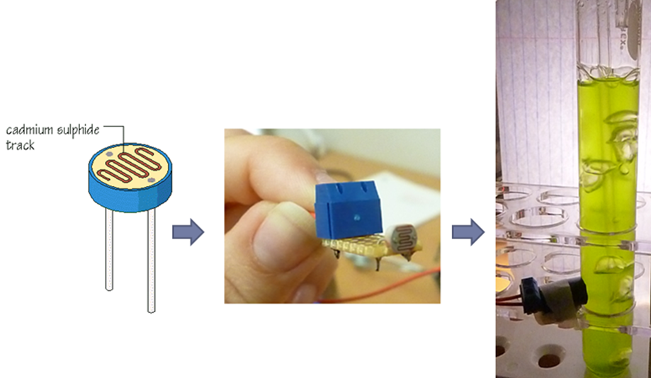
Photoresistors

Slide 15
Progress: Organization

Slide 16
Milestones
Python code completion
BeagleBone Black proto board soldered and finished.
Purchase glassware and other related parts from the stockroom in Urey Hall.
Completion of the casing/stand that will hold the system.
Testing of the IR sensors with the LED lights.

Slide 17
